Slide 1
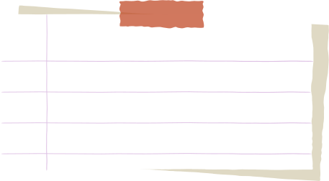


Project
Presentation
Go
Presented by Manant Tyagi

Slide 2



Hello Everyone!

Slide 3
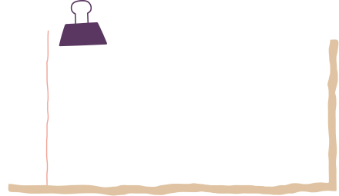


Introduction
This is a comprehensive data engineering project that focuses on analyzing and understanding global environmental and economic trends through the lens of CO2 emissions, renewable energy consumption, and electric energy consumption. By leveraging three distinct CSV files, we've built a robust data pipeline using Informatica to ingest, organize, and analyze the data. This structured approach allows us to uncover insights and trends, providing a foundation for informed decision-making and policy recommendations. The project not only showcases the application of data engineering techniques but also emphasizes the importance of data organization and analysis in driving sustainable development and economic growth.

Slide 4


Project Stages
A
B
C
Analyzing the attributes in the staging tables to create dimension tables and then loading the data from staging to dimension tables.
Creating the Staging tables and then creating the data pipelines to load the data from source files to these tables.
Creating a fact table by the dimension and staging tables implementing all the primary and foreign key constraints.

Slide 5
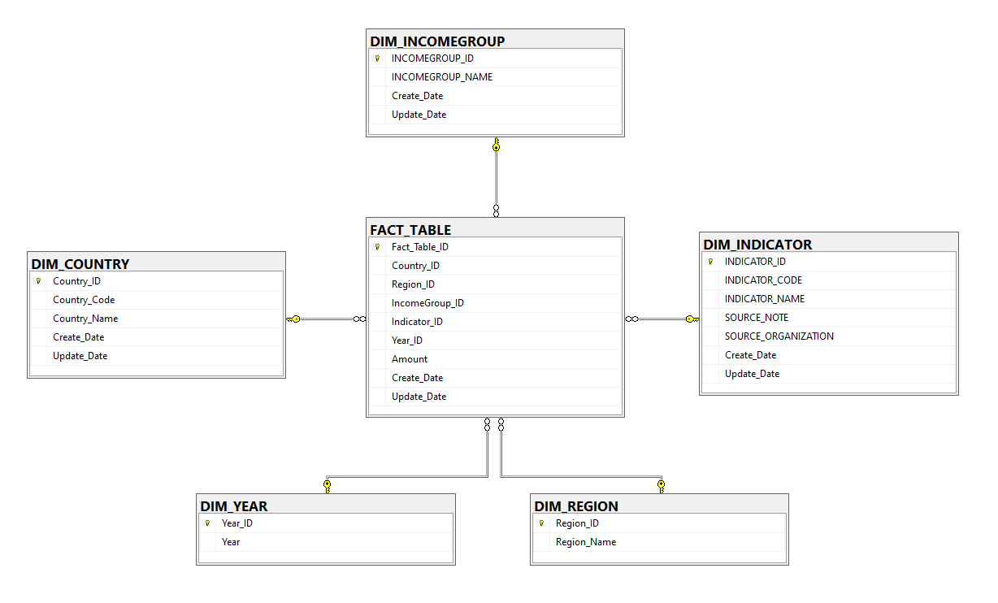
DATA MODEL

Slide 6

Process
First lets check the loading strategy used in creating the staging table.
Design and analysis of the loading strategy used for the fact table.
1.
3.
After that we will analyze the loading strategy used in the creation of the dimension tables.
Python Analysis and SQLinsights that we get from the data present in the fact and dimension tables
2.
4.

Slide 7
STAGING
1) There are 3 CSV files for the first staging table and it includes of various indicator names.
2) From the CSV file all the years that are present as columns are converted to rows using normalizer transformation.
3) Union transformation is used to group all the records that are coming from these three files and then passed to normalizer transform.

Slide 8
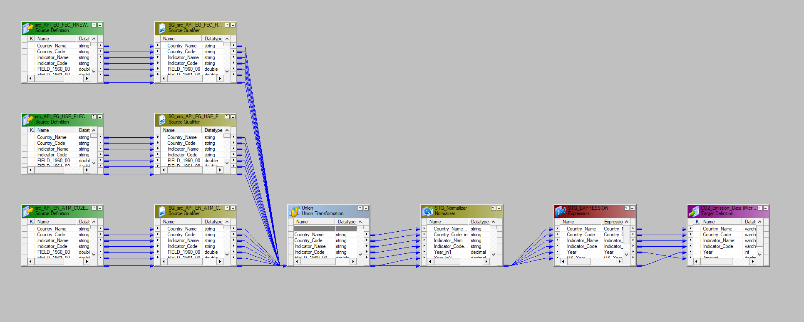
STAGING

Slide 9
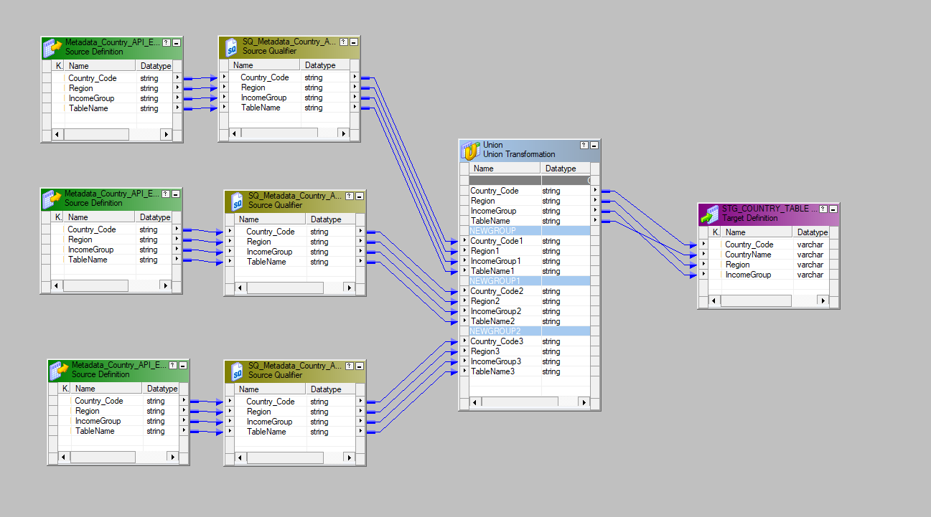
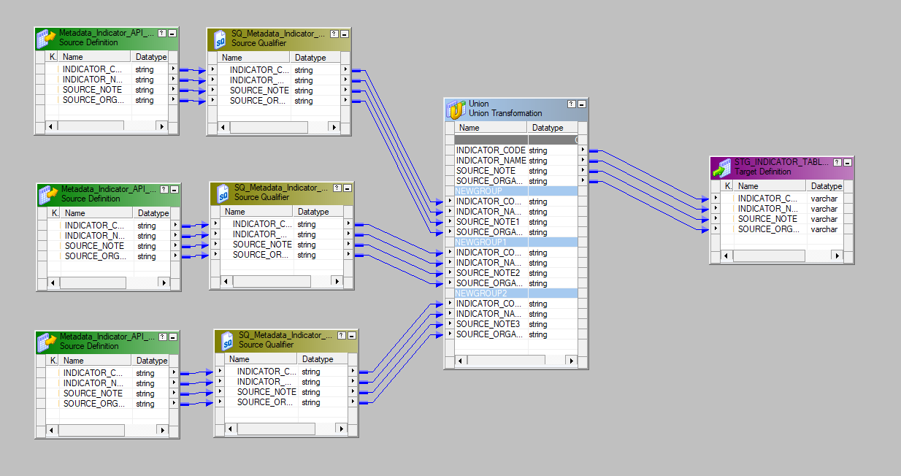
STG_COUNTRY_TABLE
STG_INDICATOR_TABLE

Slide 10
DIMENSION
1) In the DIM_COUNTRY table, we are using the STG_Emission_Data as the source table.
2) We are using an expression transformation to add the create and update date for the data in the table. For some change in data we are using update strategy.
3) A lookup transform is done on the DIM_COUNTRY table to check whether the data is loaded for updating or inserting by matching the Country_Code and then using a router transformation to divide the data in groups according to the conditions.

Slide 11
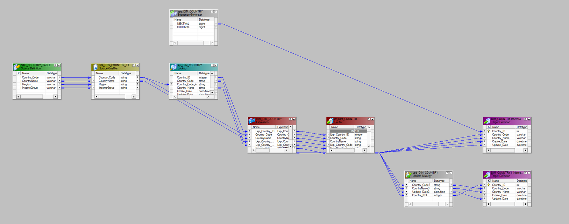
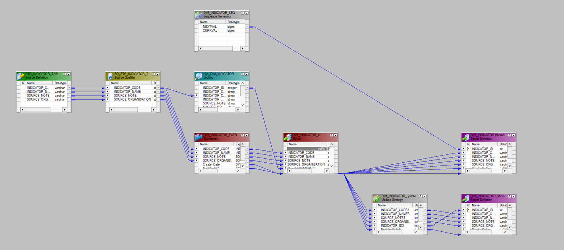
DIMENSION

Slide 12
FACT TABLE
1) For the Fact table creation, we are using two staging tables and joining them using joiner transformation on the basis
of Country_Code.
2) We are doing unconnected lookup on all the 5 dimension tables to get the respective ID’s and using the expression transform to pass the fields to the lookup for the condition check.
3) Router transformation is used to either insert or skip the data based on the value of FACT_TABLE_ID

Slide 13
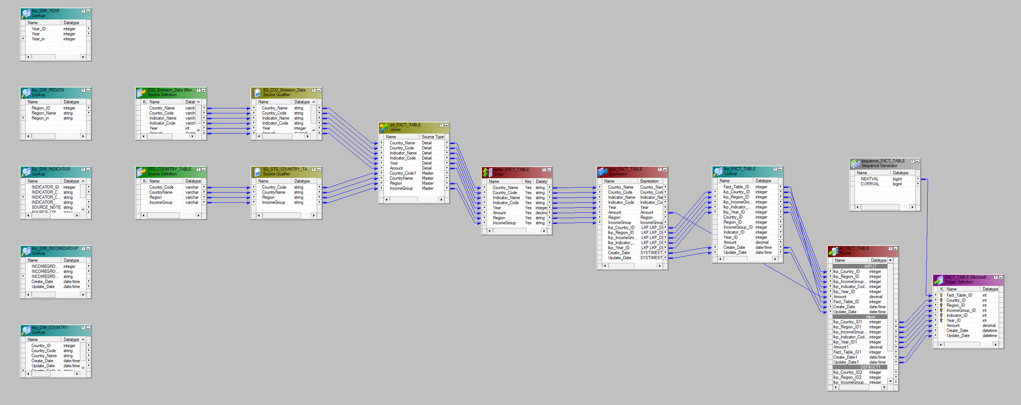
FACT TABLE

Slide 14
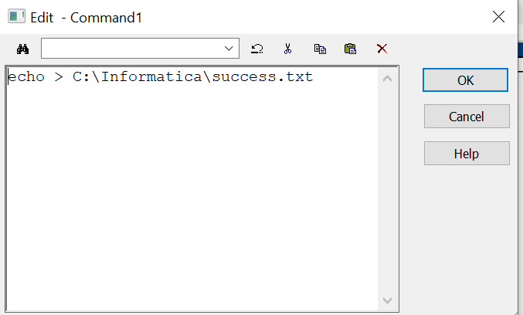
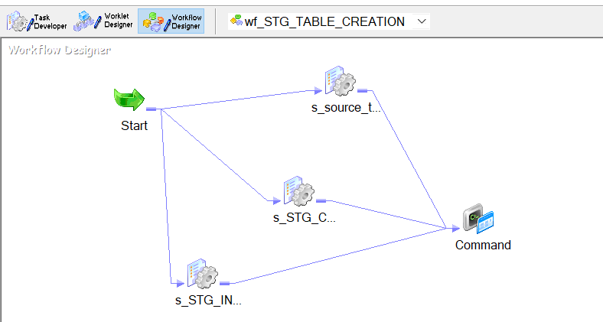
Staging Workflow
Event-Wait

Slide 15
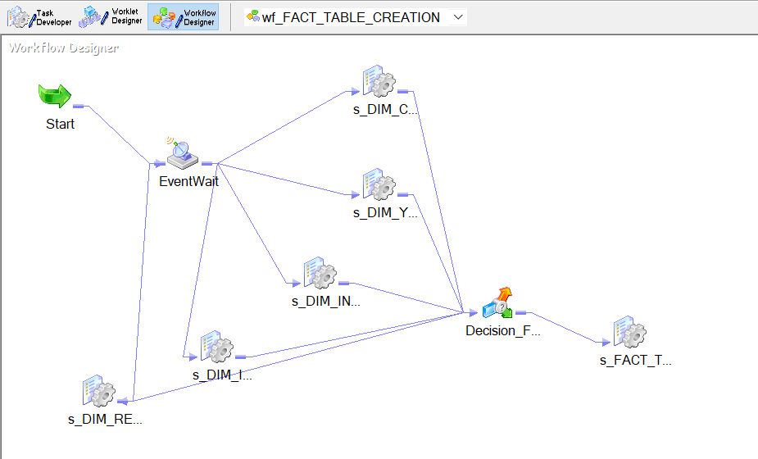
Fact Workflow Event-Wait

Slide 16
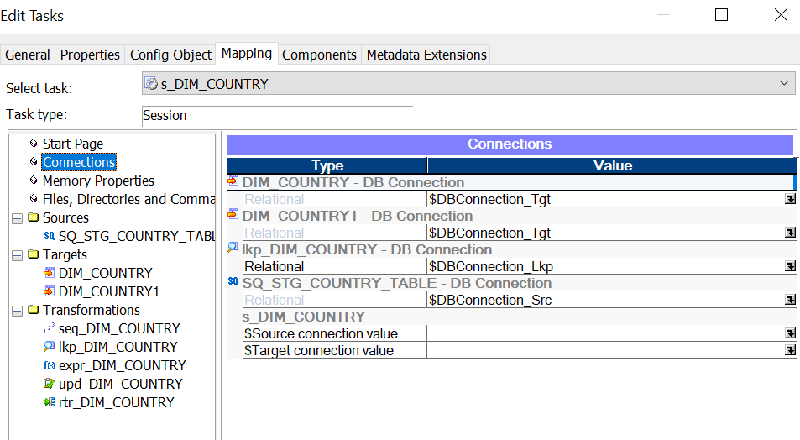
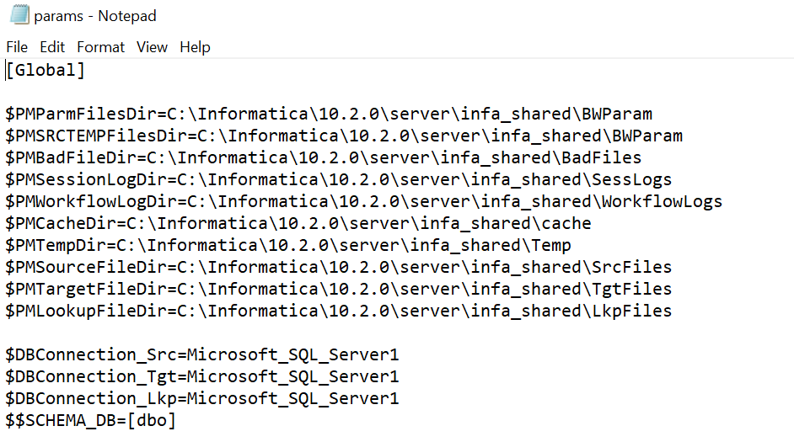
Parameter File

Slide 17
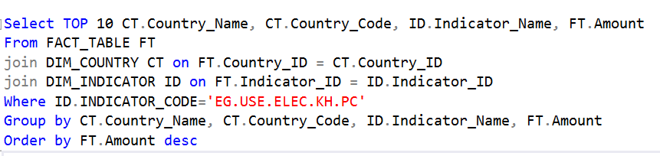
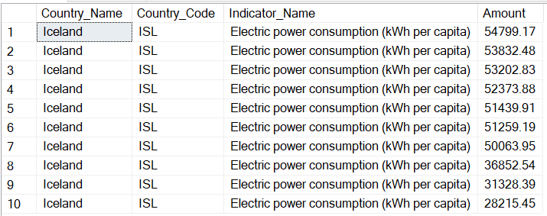
INSIGHTS
Top 10 Countries with the highest Electric power consumption (kWh per capita)

Slide 18
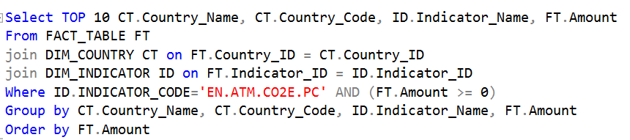
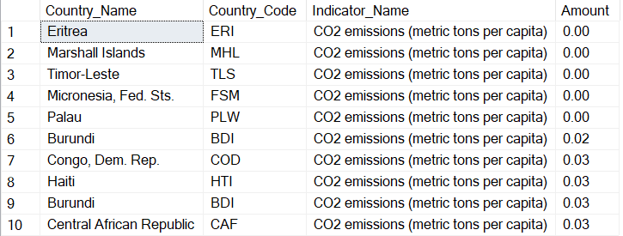
INSIGHTS
Top 10 Countries with least CO2_Emission_Amount

Slide 19
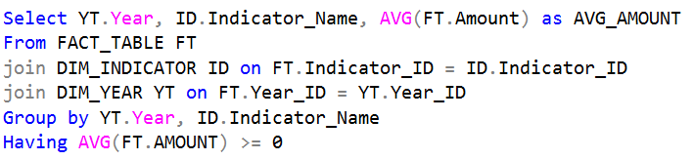
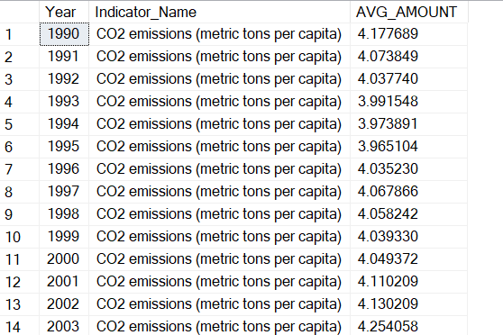
INSIGHTS
Average Amount of CO2 released worldwide each year

Slide 20
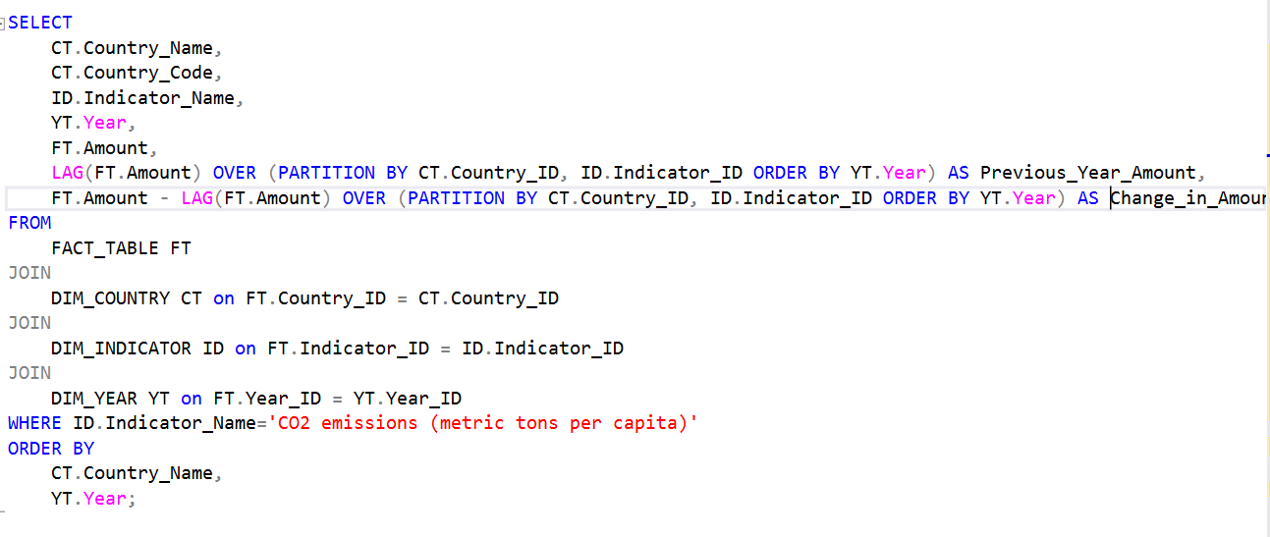
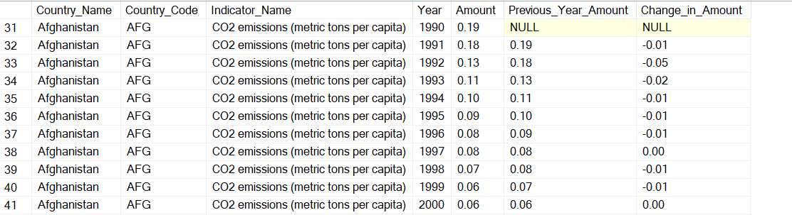
INSIGHTS
Change in CO2 Amount compared to previous year for every country

Slide 21
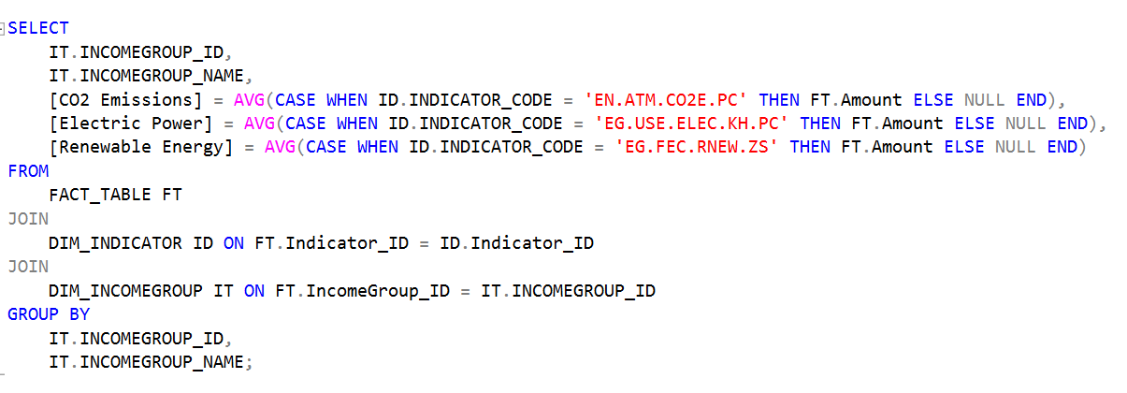
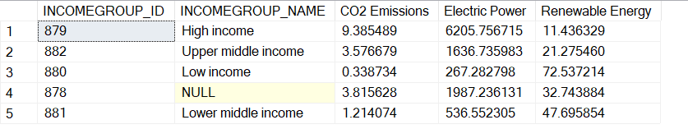
INSIGHTS
Average CO2 released, Electric energy consumption and Renewable energy consumption by each Income_Group

Slide 22
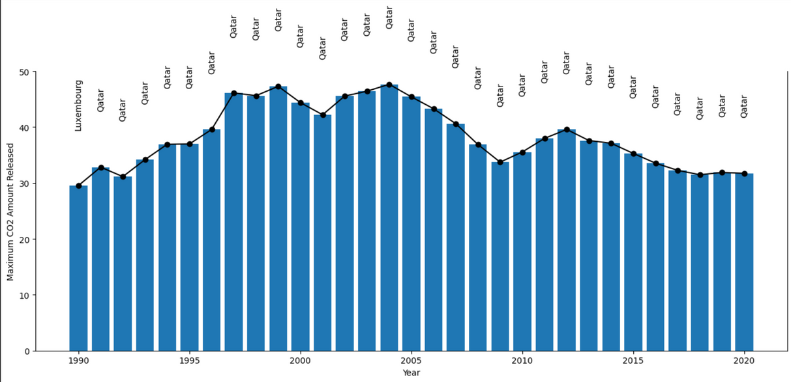
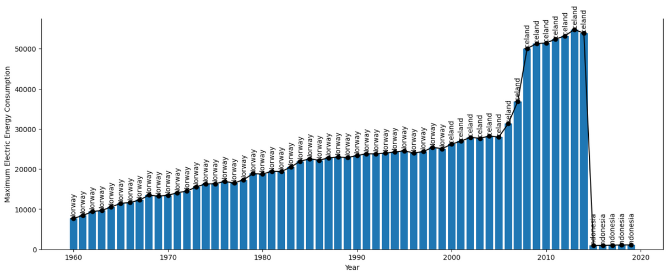
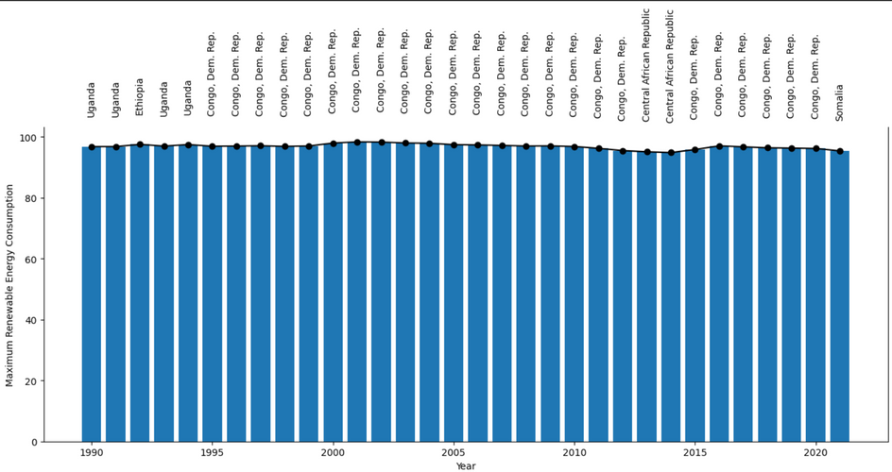
Plot Analysis

Slide 23
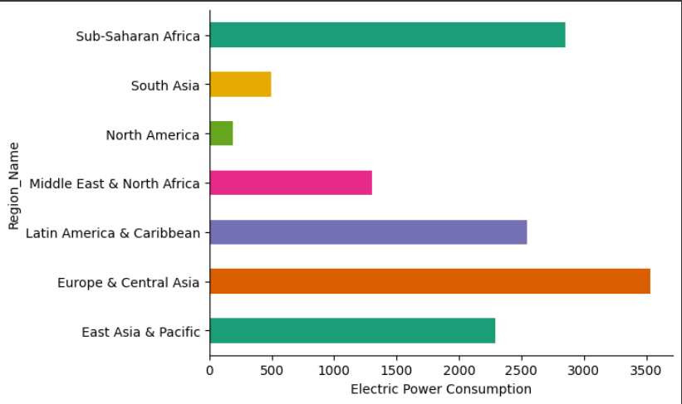
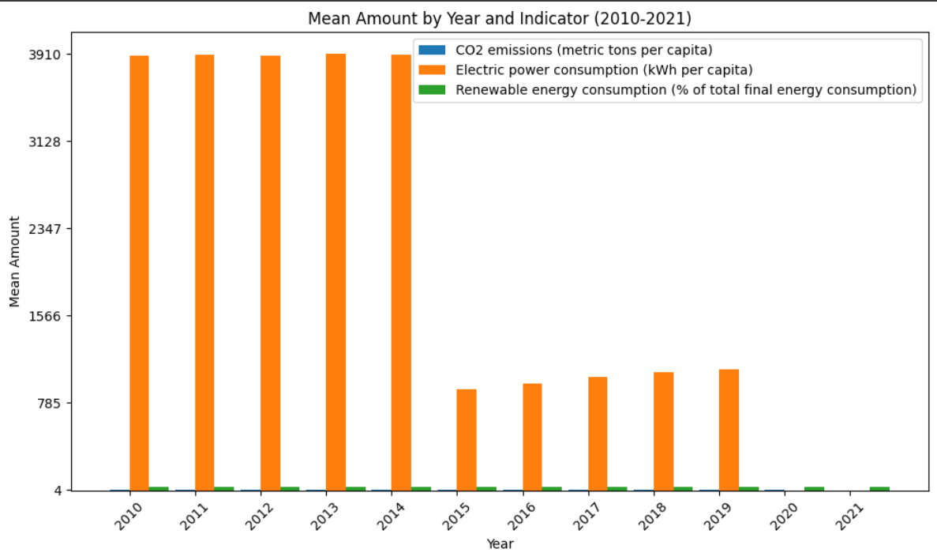
Plot Analysis

Slide 24
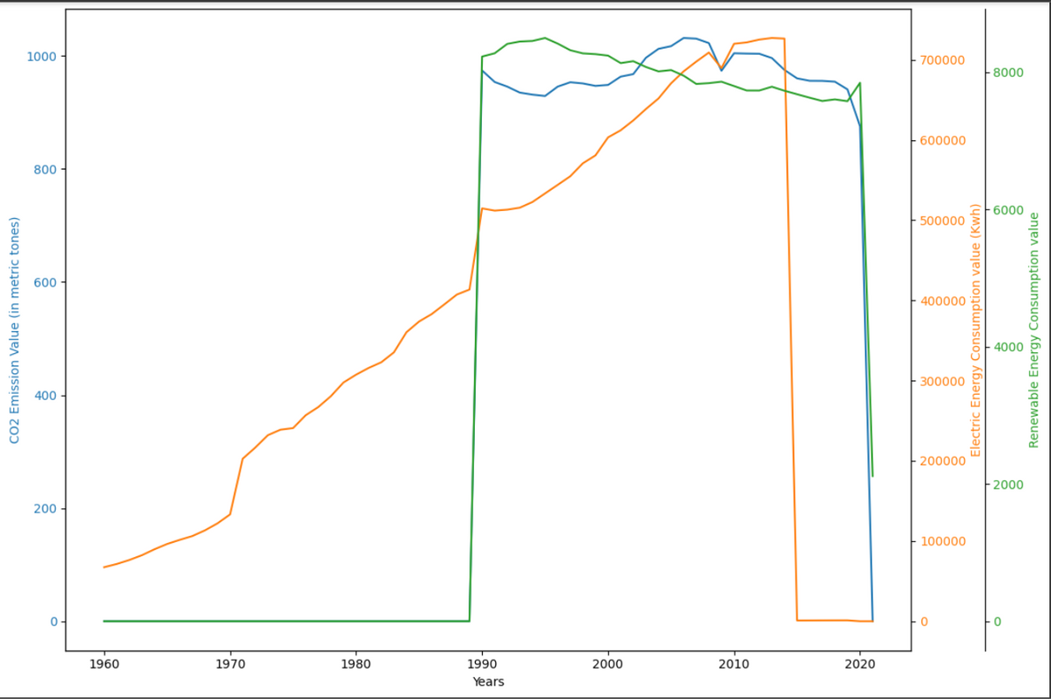
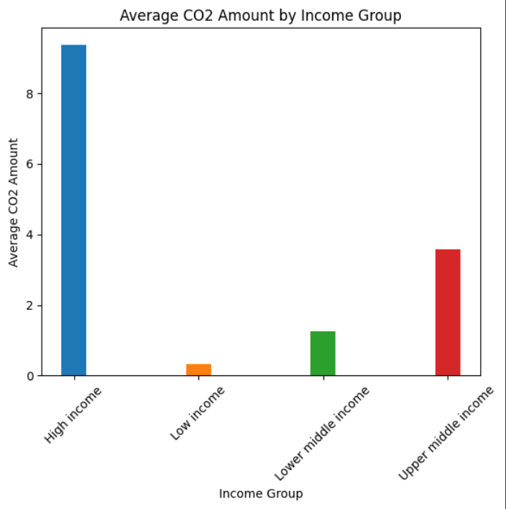
Plot Analysis
Line graph for change noticed every year

Slide 25
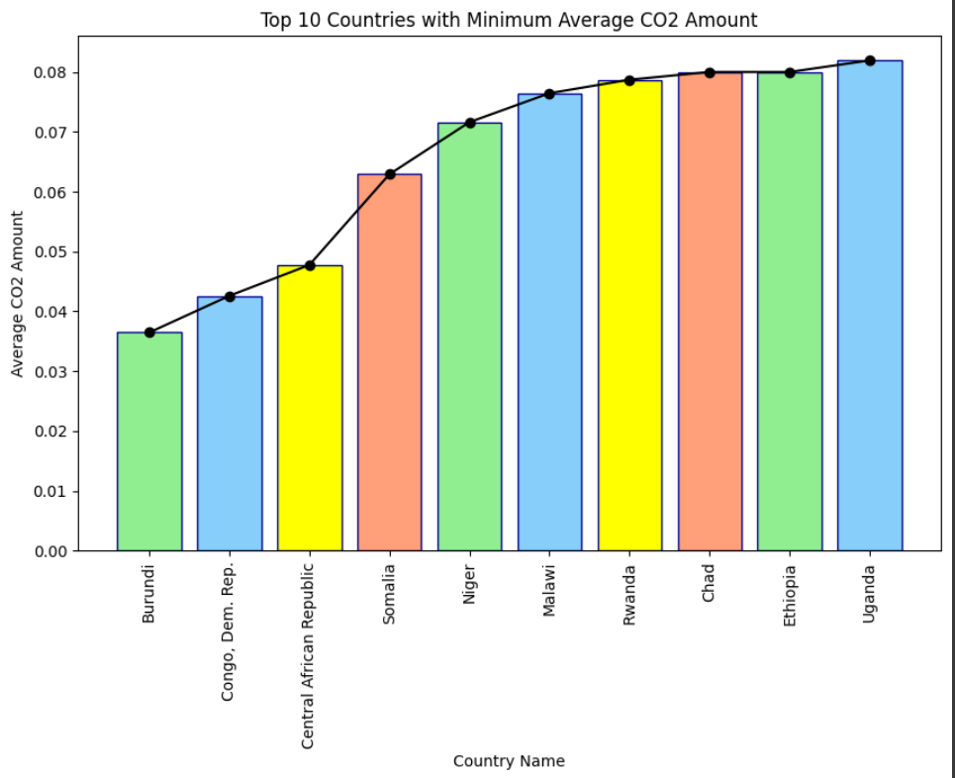
Plot Analysis

